Slide 1
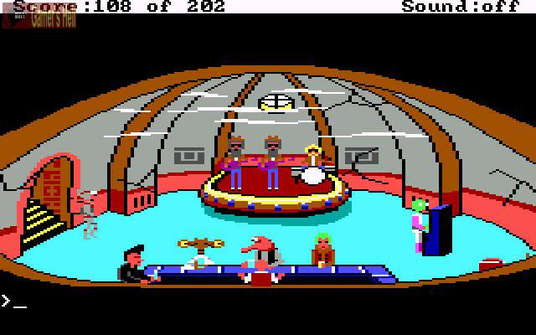
CSE 380 – Computer Game Programming
Sprite Animation
Space Quest, by Sierra, released 1986

Slide 2

Sprites
We’ve used LPD3DXSPRITE to draw tiles. Why?
  it has easy to use methods for drawing
  automatic clipping
What is a sprite really?
  a series of 2D images that makeup an animated character

Slide 3
What can sprites be used for?
Main character
Enemies
Any living thing
Projectiles (rockets, bullets, arrows, rocks, etc.)
Vehicles
And more

Slide 4

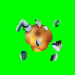




Animating Sprites
As a sprite moves, we must display it using different “frames of animation”
  this means slightly different images
Works just like traditional cartoon animation
Animation must be:
  tied to timer
  tied to movement (for main character)

Slide 5
Sprite Data
Suppose we wanted to draw an animated Mario, what data might we need?
  position
  z-order (huh?)
  velocity
  Texture(s)
    array of Textures if using individual images
    each index represents a frame of animation
  possible states of sprite
  current state of sprite (standing, running, jumping, dying, etc.)
  animation sequences for different states. Huh?
  current frame being displayed (an index)
  animation speed

Slide 6
Animation Sequence Example
0
1
2
3
4
5
Condor Frames
  indices 0-5
Condor Living
  [0,1,0,2]
Condor Dying
  [3,4,5]
Easy way of doing this: 2D data structure
  state X frame sequences

Slide 7
Defining your own sprite class
We only want to use Direct3D’s Sprite class for drawing
No class exists to store all the data we want
So, define your own
  AnimatedSprite
Draw using Direct3D Sprite

Slide 8
How do we advance animation frames?
Sprites should also have an animation speed
Every game loop iteration, for each visible animated sprite:
  Is the sprite currently in an animated state?
  If yes, has enough time has passed since last frame advance? (use animation speed to judge)
  If yes, advance frame according to current animation in use

Slide 9
How do we change sprite states?
Each game loop iteration:
  get user input
  Does user input change sprite state?
  If no, change sprite values per current state
    e.g., change location using velocity & direction
  If yes, change sprite state and reset animation in use
Change states of all sprites as well
  based on AI
Then we would perform collision detection and any necessary corrections (next time)

Slide 10
What do we do with dead sprites?
most likely remove them from memory
perhaps have a newly dead state
  keep the corpse around a little while
visible dead sprites use resources
most games, new and old, have vanishing dead guys
  Legend of Zelda
  to
  Call of Duty: Big Red One

Slide 11
Sprite states and movement
Sprites movement may be tied to state
E.g., in game loop, how should one:
  update the position of a bullet
    add velocity to position in constant direction
  update the position of a walking Mario
    add velocity to position in current direction
  update the position of a jumping Mario
    change direction & velocity
    add new velocity to position in new direction

Slide 12
The Big Picture in UML
GameStateManager
1
1
*
1
SpriteManager
AnimatedSpriteType
1
1
*
Bot
1
1
AnimatedSprite
CollidableObject
PhysicalProperties
1
*
BoundingVolume

Slide 13
SpriteManager
class SpriteManager
{
private:
vector<AnimatedSpriteType*> *spriteTypes;
list<Bot*> *bots;
AnimatedSprite player;
BotRecycler recyclableBots;

Slide 14
AnimatedSprite
class AnimatedSprite : public CollidableObject
{
private:
AnimatedSpriteType *spriteType;
int alpha;
wstring currentState;
unsigned int frameIndex;
unsigned int animationCounter;

Slide 15
AnimatedSpriteType
class AnimatedSpriteType
{
private:
int spriteTypeID;
map<wstring, vector<unsigned int>*>
animationSequences;
int textureHeight, textureWidth;

Slide 16
CollidableObject
class CollidableObject
{
protected:
bool currentlyCollidable;
BoundingVolume bv;
PhysicalProperties pp;

Slide 17
PhysicalProperties
class PhysicalProperties
{
protected:
float buoyancy;
float mass;
bool collidable;
float coefficientOfRestitution;
float x;
float y;
float z;
float velocityX;
float velocityY;
float accelerationX;
float accelerationY;

Slide 18
Next Lectures
Physics Review
Collision Detection
Collision Responses

